Slide 1
Image Captioning
Team 6

Slide 2
Introduction
A quick glance at an image is sufficient for a human to point out and describe an immense amount of details about the visual scene. However, this remarkable ability has proven to be an elusive task for our visual recognition models. Generating descriptions for images has long been regarded as a challenging perception task,integrating vision, learning and language understanding. One not only needs to correctly recognize what appears in images but also incorporate knowledge of spatial relationships and interactions between objects. Even with this information, one then needs to generate a description that is relevant and grammatically correct

Slide 3
Dataset
COCO is a large-scale object detection, segmentation, and captioning dataset. COCO has several features:
Object segmentation
Recognition in context
Superpixel stuff segmentation
330K images (>200K labeled)
1.5 million object instances
80 object categories
91 stuff categories
5 captions per image
250,000 people with keypoints
MSCOCO - 2017

Slide 4
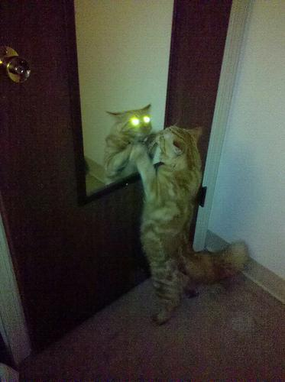
An orange cat with glowing eyes looking into a mirror.
A cat standing up in front of a mirror on the back of a door.
A cat looking at itself through a mirror.
A cat scared by its own reflection in the mirror.
A cat with shiny yellow eyes standing up to look at itself in a mirror.
Sample

Slide 5
Methodology
The ultimate goal of our model is to generate descriptions of image regions. During training, the input to our model is a set of images and their corresponding sentence descriptions. We first present a model that aligns sentence snippets to the visual regions that they describe through a multi-modal embedding. We then treat these correspondences as training data for a second, multi-modal Recurrent Neural Network model that learns to generate the snippets. Our multimodal Recurrent Neural Network generative model. The RNN takes a word, the context from previous time steps and defines a distribution over the next word in the sentence. The RNN is conditioned on the image information at the first time step. START and END are special tokens.

Slide 6
Image
VGG16
Tokenization & Batching
RNN
A Input Image resized to (224,224.3).
Used pre-trained model of VGG16 on ImageNet Weights for object detection .
The Captions were converted it to numeric value without loss of any information so that the RNN model can work on it and Batch size of 512 was created to be forwarded to RNN model.
RNN Contains three staged layer of GRU.
Which helps in producing a proper a complete sentences from VGG16 identified objects.

Slide 7
Object Detection
We used pre-trained VGG16 model on ImageNet for Objects Detection in Input Image.

Slide 8
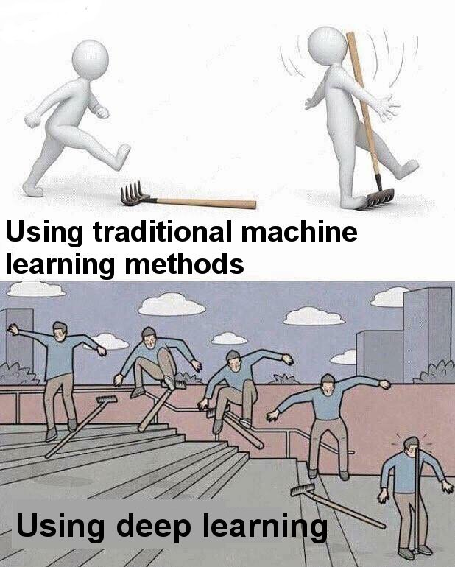
RNN
For text generation part we used RNN it takes in input the Image Object Detected features and Tokenized Caption for the particular match which leads to output of a full sentences explaining the image.

Slide 9
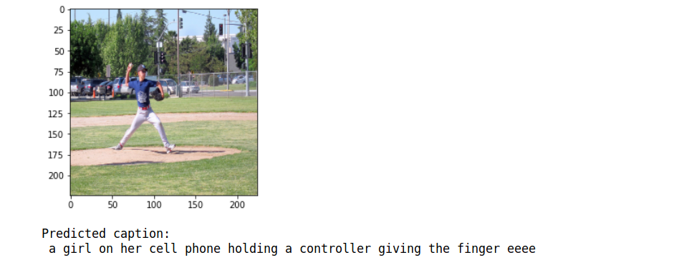
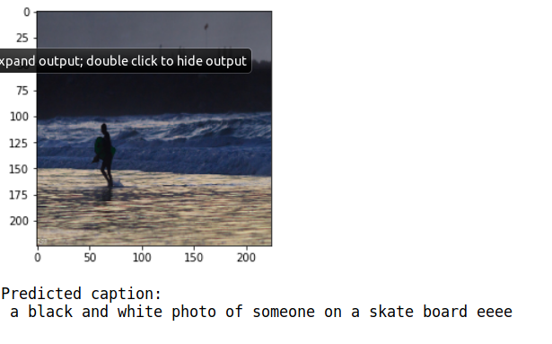
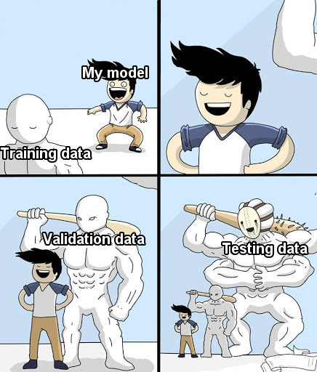
Results

Slide 10
